Slide 1
Suspense at the Wildlife Preserve “Cheep” Shots
COMP 4449: Capstone | Summer 2023
Sammantha Firestone
Notes:
Hello my name is Sammy Firestone and I will be presenting my results for the Suspense at the Wildlife Presevere Cheep Shots.

Slide 2


THE SCENIARO
LOCATION | Boonsong Lekagul Wildlife Preserve
WHEN | Late March of 2018
BIRD OF INTEREST | Rose-Crested Blue Pipit
DEFENDANT | Kasios Office Furniture Manufacturing Firm, Mistford City
COMPLAINANT | Mitch Vogel, post-doc student at Mistford College
Notes:
This scenario is located at the Boonsong Lekagul Wildlife preserve and this is occurring late March of 2018.
There has been signs that show that the population of the beloved Rose-Crested Blue Pipit bird have been decreasing! Indicating a possible endangerment of the species!
Mitch Vogel and his professors from the Mistford college Society began an investigation last year implicating Kasios Office Furniturnture manufacting firm, as they were using a banned substance in their manufacturing process and dumping it in the northeast region of the preserve.
Kasios claims they have done nothing wrong and that Mitch Vogel and his professors are media seekers and have flawed and biased research. They state they are eco-friendly organization and report that they did their own investigation and found that there are plenty of Rose-crested Blue Pipits! To back up these claims they provided a set of pipit calls recently recorded across the preserve with locations where they were recorded.

Slide 3
GOALS
Characterize bird species patterns in the Preserve; Identify trends and anomalies in bird locations over time
Analyze the set of bird calls supplied by Kasios to assess the support for their claim of Pipits being present throughout the Preserve
Formulate a hypothesis regarding the status of the Pipit and propose next steps in the investigation to validate or challenge Kasios’ claims
Notes:
With this in mind, there are three goals in this scenario.
To characterize bird species patterns across the preserve
To analyze the set of birds calls provided by kasios
To formulate a hypothesis regarding the status of the blue-pip and propose next steps in the investigation

Slide 4
“CHEEP” SHOTS
WHY?
CNNs applied to audio
APPROACH.
Two Analysis Phases
Metadata Analysis (Congregation Patterns)
Audio Analysis (Binary Classification)
CHALLENGES!
Audio Preprocessing– Learning Curve!
Kernel crashing / Memory restrictions ☹
Notes:
I chose this project as I was interested in applying CNNs to audio data where as I applied it to images during the midterm project.
The approach I took for this project was to split the analysis in two– one section of analysis of the metadata, the other section for the analysis of the Audio Recordings.
The biggest challenges I faced with this project was learning about audio data and how to preprocess audio, as well as having a lot of memory issues while running my analysis.

Slide 5
Data Exploration
Data Summary
Bird Calls Vetted by Ornithology Groups & Metadata
2,081 audio recordings in total
19 Unique Bird Species
Quality Graded: A = Excellent to E = Poor
Time & Date of Recording (1983 to 2018)
X and Y coordinates
Vocalization Types
“Rose-Crested Blue Pipit” Calls provided by Kasios & Metadata
15 recordings
X and Y coordinates
Map of the Lekagul Preserve
Notes:
Before we jump into the analysis here’s an overview of the data-
We have bird calls vetted by ornithology group as well as metadata
There were over 2000 audio recordings that were of 19 unique bird species, each audio file was graded on quality, and each audio recording had the time and date of when it was recorded as well as where it was recorded.
The type of vocalization was also recorded, but it does not pertain directly to my analysis so we won’t dive too deeply into that, but I did however look into it.
Of course we also have the audio recordings provided by Kasios as well as metadata on where they captured the audio.
A map of the Lekagul preserve

Slide 6
GOAL 1
Characterize bird species patterns in the Preserve; Identify trends and anomalies in bird locations over time

Slide 7
Data Exploration
Metadata Cleaning
Quality
Remove rows with score less than B
Date
Standardize date format
Infer first day / month of the year if not provided
Dropped rows with missing values
X and Y Coordinates
Dropped rows with missing values
BEFORE CLEANING:
8 Columns | 2,081 Rows
AFTER CLEANING:
7 Columns | 1,558 Rows
Notes:
To clean the metadata I first removed all rows with a score less than B – this is mostly for my audio analysis later on, as well as help declutter some of my data analysis
I also standardized and cleaned my date column, and dropped rows with missing X, Y coordinate values

Slide 8
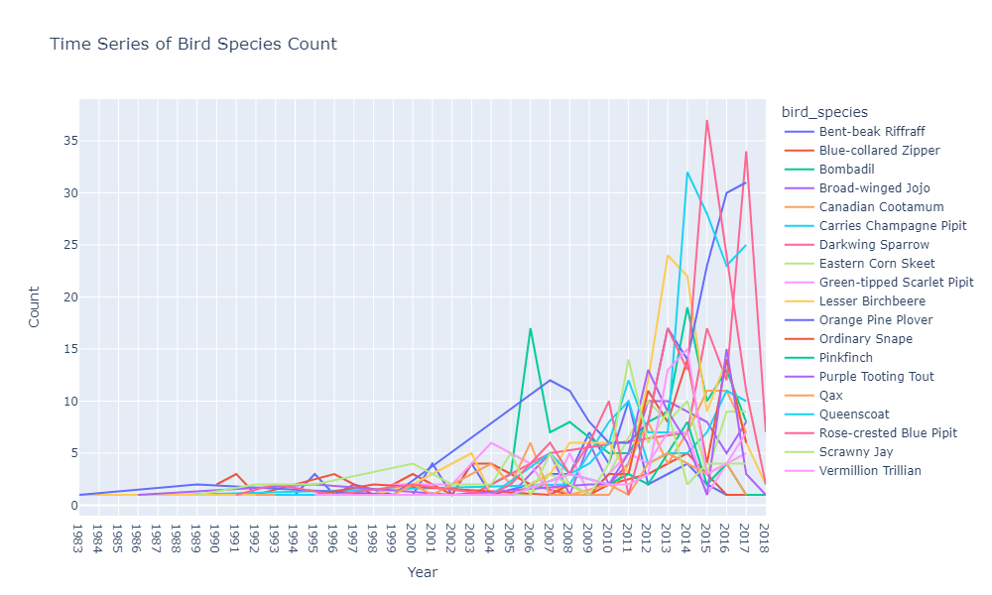
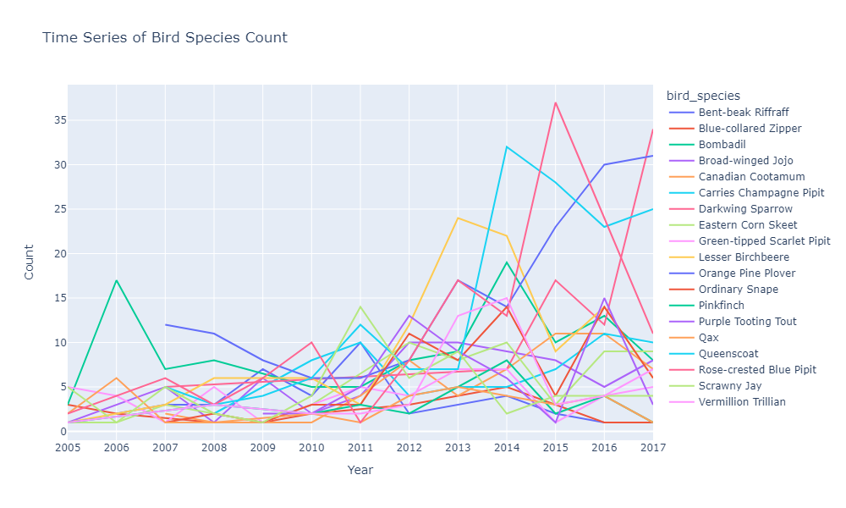
Data Exploration
Count of Bird Species Recordings in the Preserve Over Time
Big dip in bird species during 2015!
Notes:
First thing I did was look at the number of recordings over time
The number of bird calls begin to steadilty increase between 2005 to 2014, in 2015 you can see a large dip in bird call recordings for many of the bird species (the Rose-Crested Blue Pipit had a record breaking number that year though, but quickly falls off)

Slide 9
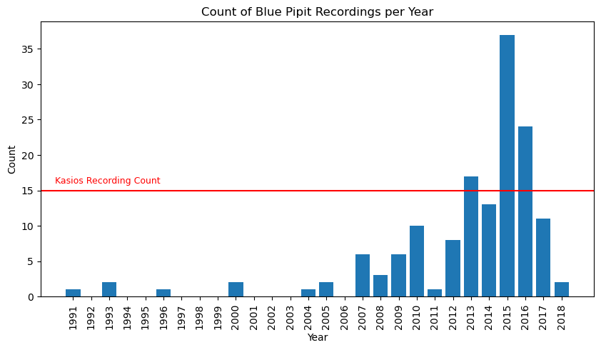
Data Exploration
Count of Rose-Crested Blue Pipit Recordings in the Preserve Over Time
Recording Breaking Count? Suspicious!
Notes:
Next think I did was look at the the number of blue pipit recordings over time.
It’s suspicious that Kasios recorded 15 blue pipit calls as it is only the 3rd month of the year. This would be highest number of calls in such a short period of time!

Slide 10
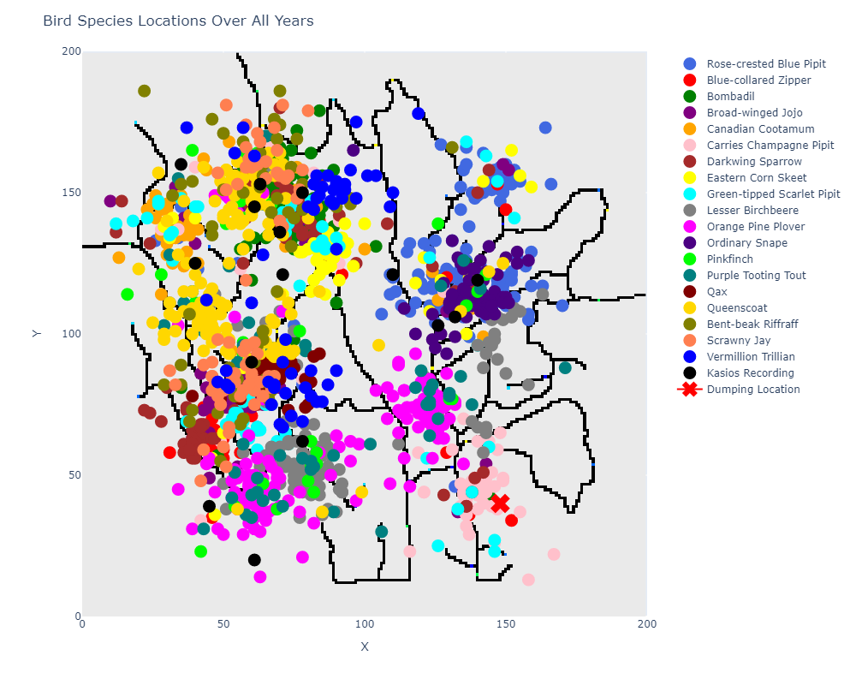
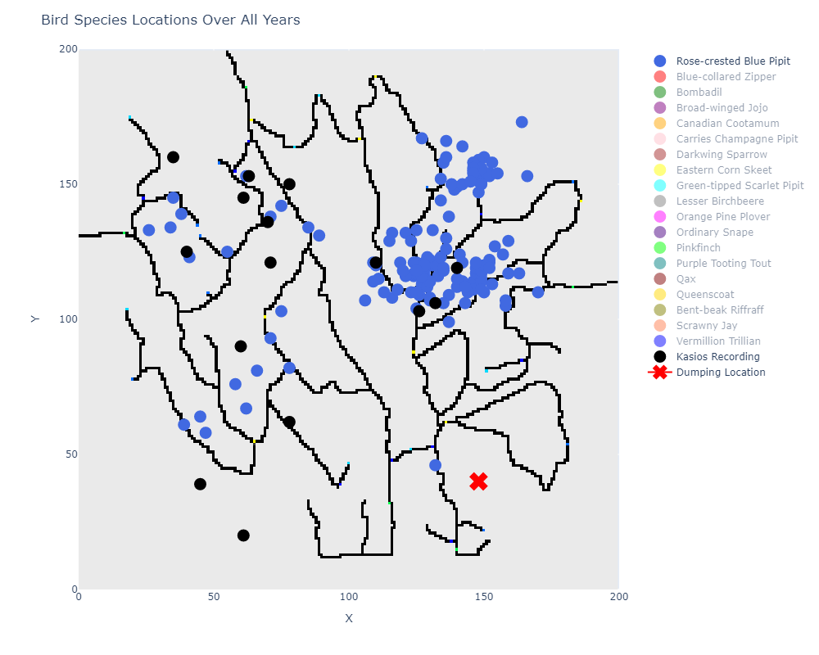
Data Exploration
Congregation Patterns of Birds in the Preserve Across Time
Birds tend to congregate in the same areas
Notes:
Next thing I wanted to understand is the migration and congration patterns of birds over time.
Here’s is the locations of the recordings overall years for all species.
In general birds tend the congregate in the same areas and there are few outliers.
The Blue pipit always seemed to congregate around the northwest corner of the preserve with some nests along the east along rivers.
Keep in mind that the northwest area of the preserve is where Mitch and his professors believe that Kasios dumped a banned substance waste from their manufacturing process there!

Slide 11
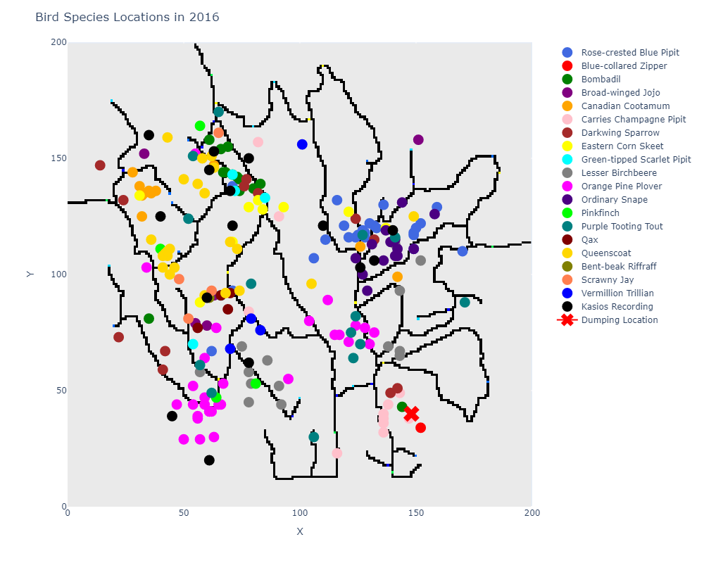
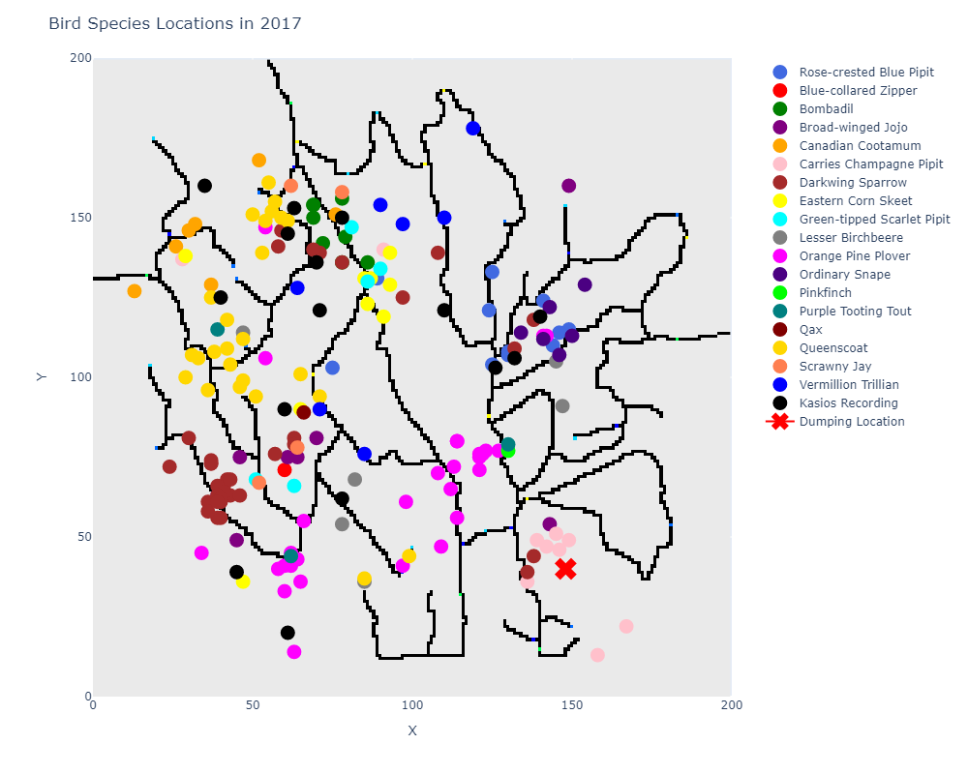
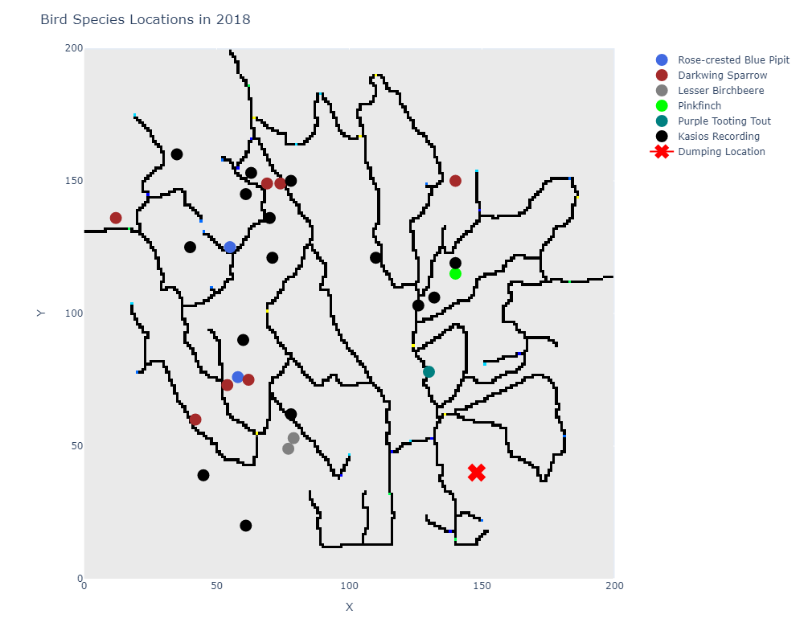
Data Exploration
Congregation Patterns of Birds in the Preserve Across Time
Kasios’ Recording Locations Don’t Line Up!
Notes:
If we focus on the last three years, this still congregation pattern still holds true, but as you can see here, the number of birds congregating in that northwest corner of the preserve have been decreasing!
What else is important to note is some of the recording locations of Kasios– some are no where near where the Blue Pipit typically congregate which is unusual. It is also interesting that they have recordings from the Blue Pipit in the NE region while the Ornthologists have not had any from that region this year.

Slide 12
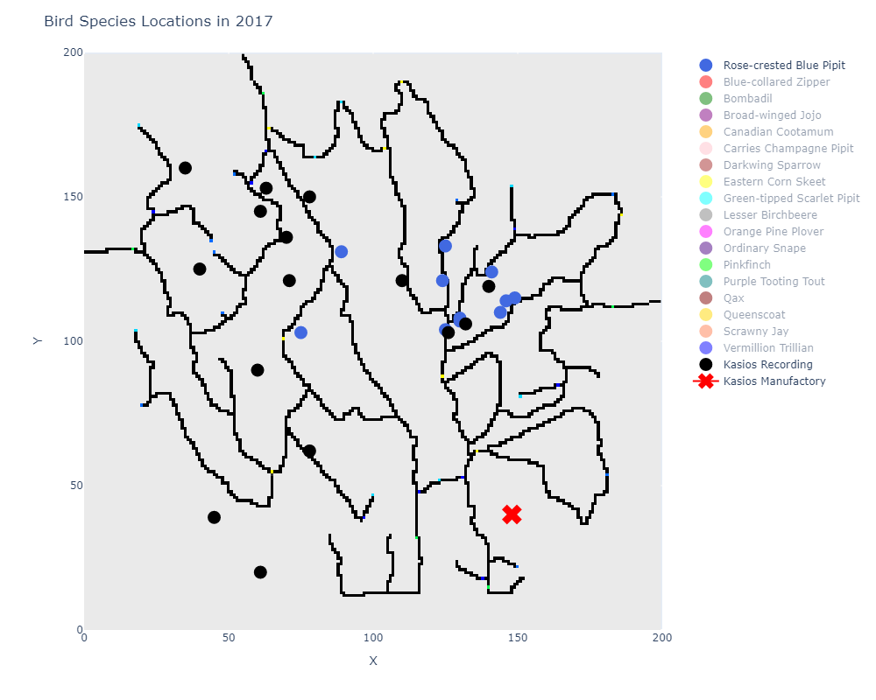
GOAL 1 CONCLUSIONS
Steady increase in all bird calls from 2005 to 2014
Dip in 13 bird species calls from 2015 to 2017
Rose-Crested Blue Pipit Call Count in 2015: 37
Rose-Crested Blue Pipit Call Count in 2016: 24
Rose-Crested Blue Pipit Call Count in 2017: 11
Birds congregate in the same location over time
Rose-Crested Blue Pipits congregate in the Northwest area of the preserve
Few of the recordings are found near rivers in the East
Suspicious locations of the Kasios recordings near the Southeastern area away from rivers and record-breaking call count
Notes:
Based on my analysis of the meta data I found the following:
There were a steady increase in all bird calls from 2005 to 2014
Then there was a dip in 13 different bird species call from 2015 to 2017
The Rose-crested blue pipit going from 37 calls in 2015 to 11 calls in 2017
Birds tend to congregate in the same location over time
The majority of the blue-pipit population liked to congregated in the northwest region of the preserve, with a few groups in the east side near rivers

Slide 13
GOAL 2
Analyze the set of bird calls supplied by Kasios to assess the support for their claim of Pipits being present throughout the Preserve

Slide 14

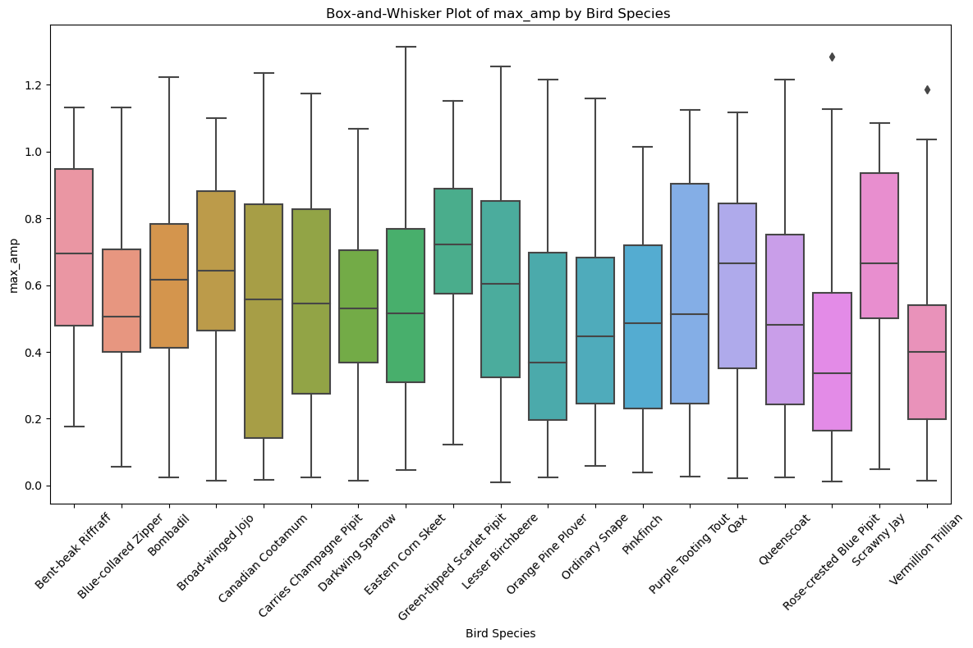
Data Exploration
Initial Audio Preprocessing Cleaning & Exploration
Append Filename
Add filename to metadata to refer to
Convert mp3 to wav
Librosa library requires wav files
High-level audio analysis
Duration | Max Amplitude | Max Frequency
Listening & Visualize to Bird Calls and Songs
Rose-Crested Blue Pipit
Kasios Recordings
Other birds of interest
Notes:
First thing was some initial preprocessing, cleaning, and visualizations.
I appended all the filenames to the metadata so I could refer to it
I had to convert all my audio files from mp3 to wav
I did some high level audio analysis, comparing duration, max amplitude and max frequency of all the different bird species
And I listened to A LOT of bird calls

Slide 15
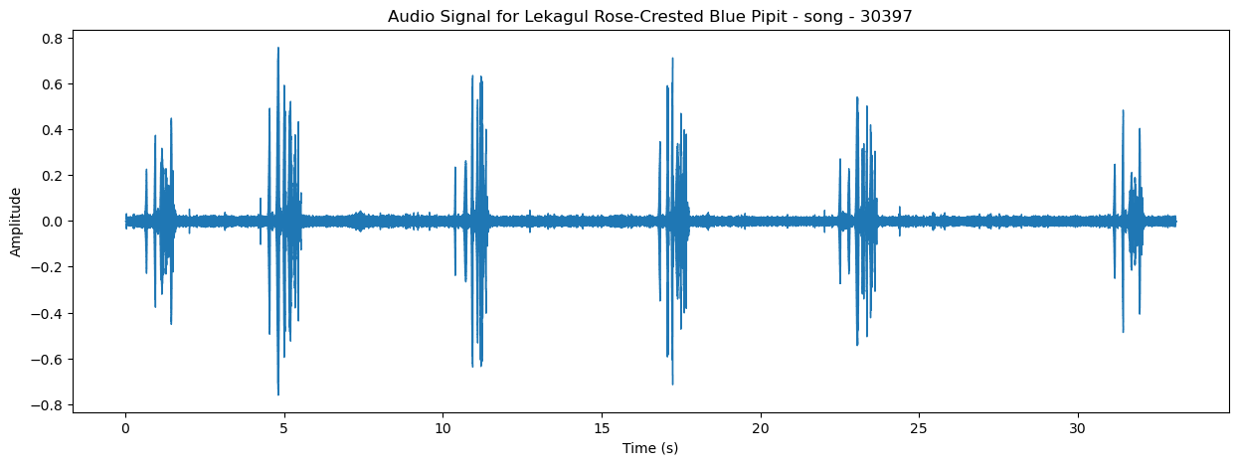
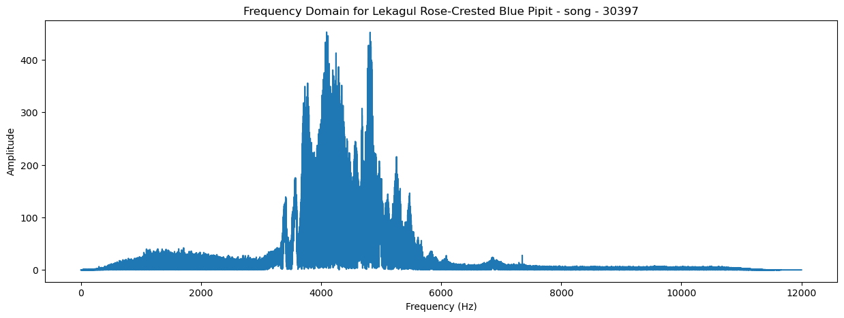
Data Exploration
Audio Exploration: Rose-Crested Blue Pipit Song
Cheeps every 5 to 10 seconds
--------------------------------
High amplitude around 4khz
Notes:
Here is a Waveform for the Rose-Crested Blue Pipit Song you can see it has cheeps every 5 to 10 seconds
Here is a frequency domain plot which his obtained by fast fourier transforms, which shows that we have high amplitude in frequencies around 4khz

Slide 16
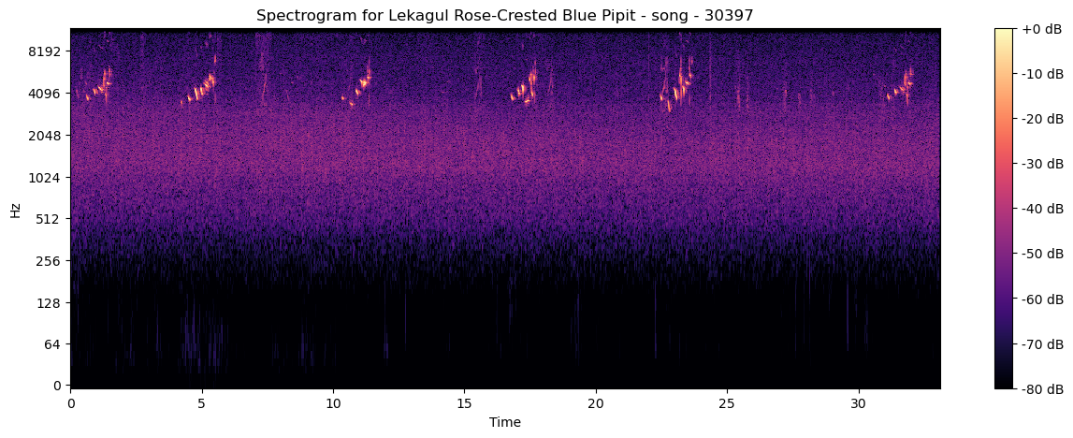
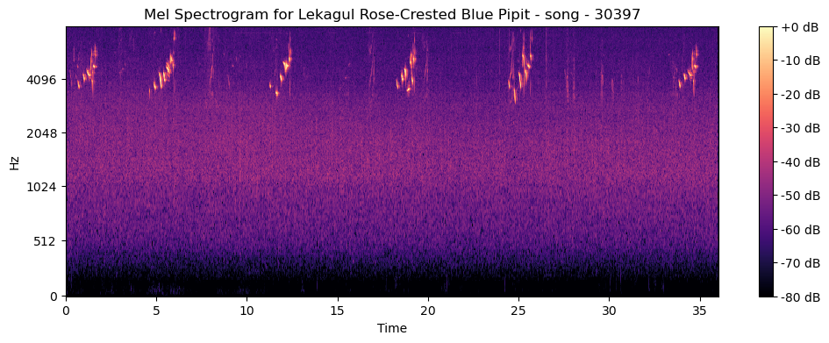
Data Exploration
Audio Exploration: Rose-Crested Blue Pipit Song
Cheeps every 5 to 10 seconds
--------------------------------
High amplitude around >4khz
Notes:
I also plotted a Spectrogram which is essentially a combination of the the other two plots I just showed. IT is obtained by applying the short time fourier transform to the audio signal which breaks the signal into short overlapping segments and computes the frequency content for each segement. You can see the magnitude of those frequencies over time by the the color – the brighter the color the higher the amplitude.
The melspectrogram is essentially the same thing however it uses the mel scale which just compresses the frequency axis to the parts that better represent humans percepotions of sound.
The main purpose of using the mel scale in a mel spectrogram is to better represent human perception of sound. By using the mel scale, the mel spectrogram groups frequency bins in a way that aligns more closely with how humans perceive pitch. This makes it especially useful for tasks like speech and music processing, where understanding the mel-frequency characteristics is more relevant than the raw frequency content.
In summary, while both spectrograms and mel spectrograms visualize the frequency content of audio signals over time, the mel spectrogram uses the mel scale to better represent the human auditory system's sensitivity to different frequencies, making it more suitable for certain audio processing tasks.

Slide 17
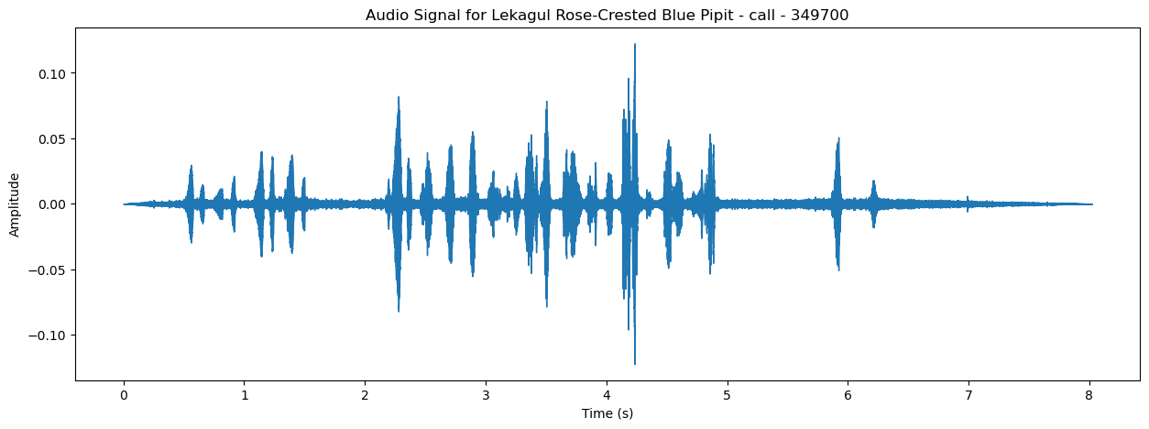
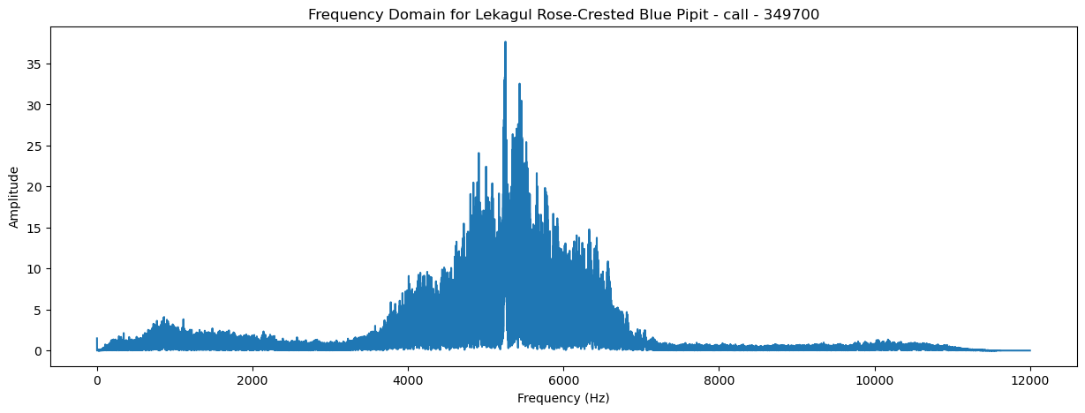
Data Exploration
Audio Exploration: Rose-Crested Blue Pipit Call
Rapid cheeps!
--------------------------------
High amplitude around >4khz
Notes:
Here’s the waveplot and frequency domain plot for the call – much more rapid cheeps and again has high ampltidue over 4Khz

Slide 18
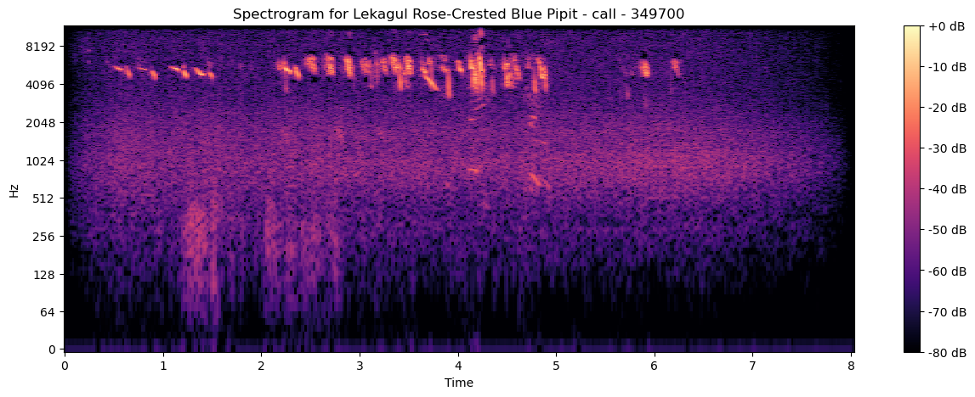
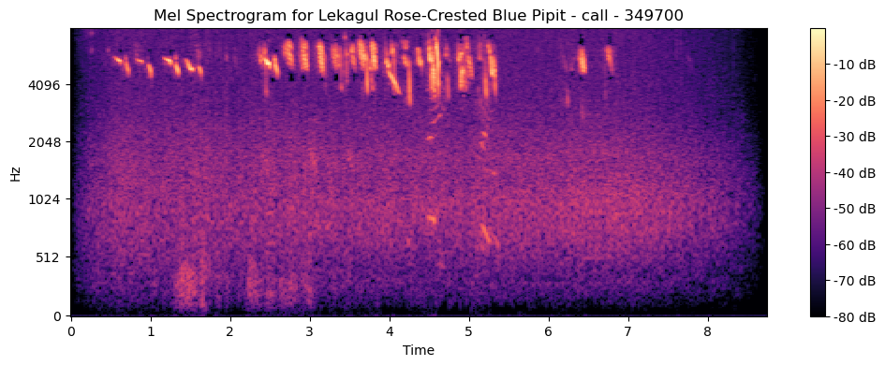
Data Exploration
Audio Exploration: Rose-Crested Blue Pipit call
Rapid cheeps!
--------------------------------
High amplitude around 4khz
Notes:
And here’s the spectrogram and mel spectrogram

Slide 19
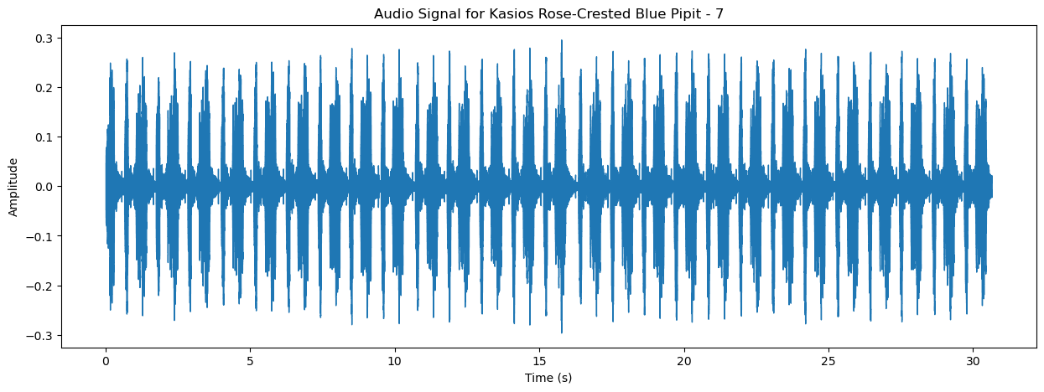
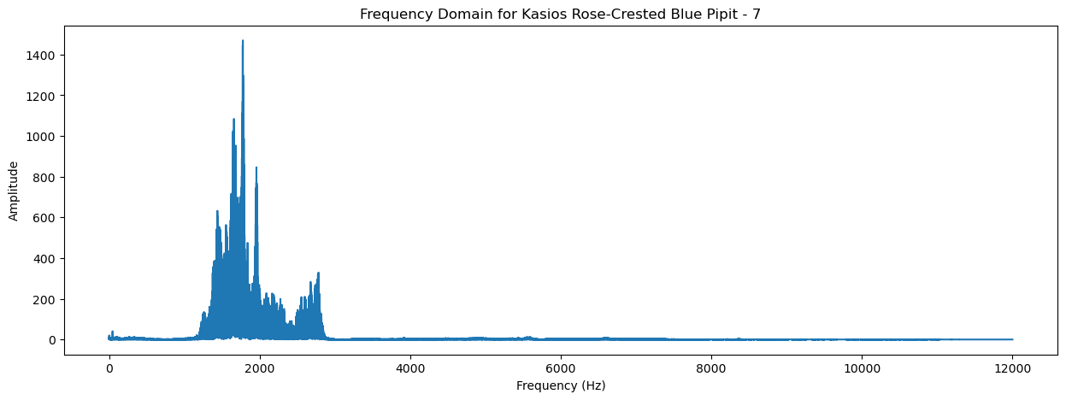
Data Exploration
Audio Exploration: Kasios’ Recording
Cheep pattern is extremely fast
--------------------------------
High amplitude around 2khz
Notes:
Now here’s an visual representation of a sample of the Kasios recordings.
Wow that bird cheeps fast! And we are getting high amplitudes around 2kHz– that’s a lot lower than what we saw with our Orinthologist group’s data.

Slide 20
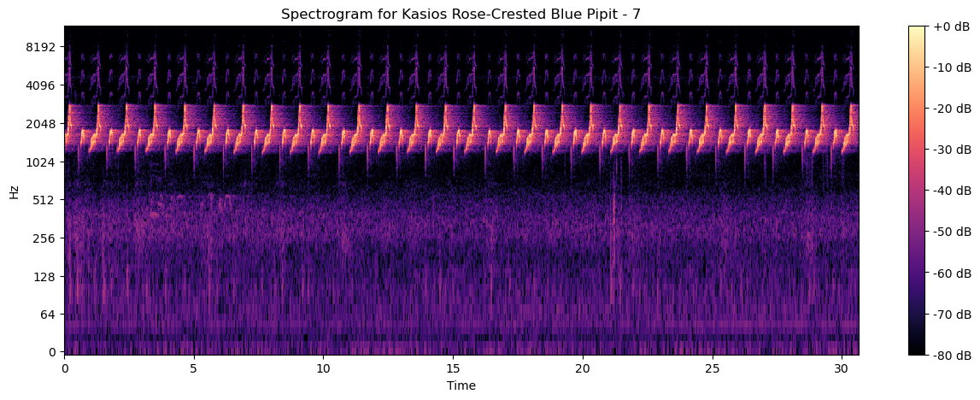
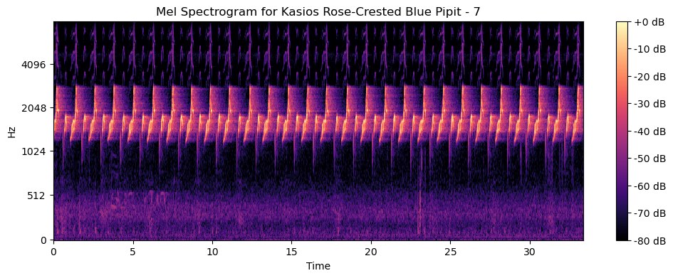
Data Exploration
Audio Exploration: Kasios’ Recording
Cheep pattern is extremely fast
--------------------------------
High amplitude around 2khz
Notes:
And here is the spectrogram and melsprectroram– highlight how much lower than frequency is and how different that pattern is.

Slide 21
CNN Modeling: Preprocessing
Audio Preprocessing For CNN Model
Extract Mel-Spectrogram
n_mels = 128 | n_bands = 5
Shorten audio to 30 seconds
<30 seconds -> Pad with zeros
>30 seconds -> Get center and trim
Undersampling & Oversampling
RUS majority (not Blue-Pipit)
ROS minority (is Blue-Pipit)
Min-Max Scaling
Required for CNN Models
Create CNN Model
x2 Conv2D Layers | x2 MaxPooling2D Layers
Flatten Layer
X2 Dense Layers | 1x Dropout Layer
BEFORE RANDOM SAMPLING:
Is Blue-Pipit: 150 | Not Blue-Pipit: 1,439
AFTER RANDOM SAMPLING:
Is Blue-Pipit: 500 | Not Blue-Pipit: 500
Notes:
To get my data ready for a CNN model I had to prepare the data.
I extracted the values from my Mel-Spectrogram (with 128 frequency bins and 5 triangular filters)
I shortend all audio files to 30 seconds
I RUS the majority and ROS the minority and of course Mix-Max scaled for me model
I did a lot of array reshaping and flattening during these steps but I won’t bore you with those details.

Slide 22
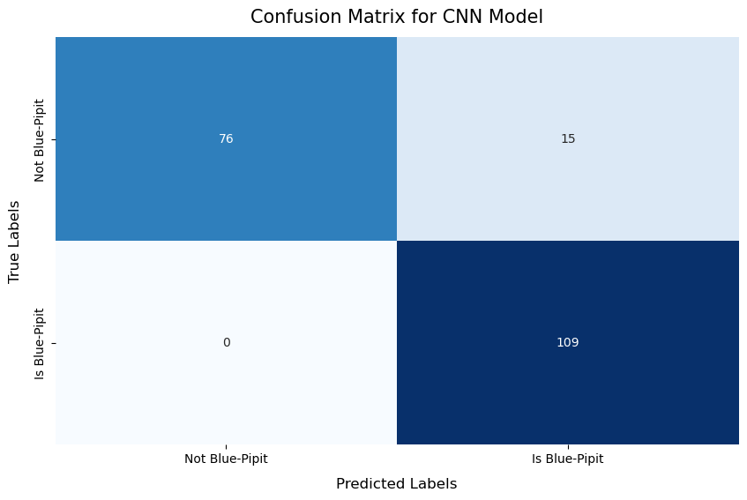
CNN Model: Performance
CNN Model Performance Metrics and Predictions
TESTING METRICS
PRECISION | 87.90%
RECALL | 100.00%
F1 SCORE | 93.56%
ACCURACY | 92.50%
TRAINING ACCURACY | 96.71%
Predicted that NONE of Kasios’ recordings are Blue-Pipits
Notes:
The overall performance on my CNN model was pretty good. I wasn’t happy that the training accuracy was slightly higher than my testing accuracy but having 100% recall was very ideal.
As you can see from the confusion matrix, no Blue-Pipit Bird calls were classified as Not Blue Pipit.
When predicting on the audio samples provided by Kasios, the model predicted that NONE of the recordings were the Blue Pipit

Slide 23
Binary Classifier Models: Preprocessing
Audio Preprocessing For Binary Classifiers
Extract the Mel-frequency cepstral coefficents (mfccs)
mfccs = 16
Take the mean at each mfccs
Used entire duration of audio recordings!
CNN model limited to 30 second clips
Randomly Oversample
ROS the minority class (Is Blue-Pipit)
Train and Test Different Binary Classifier Models with GridSearch
Logistic Regression | Random Forests | Support Vector Machines
BEFORE RANDOM SAMPLING:
Is Blue-Pipit: 150 | Not Blue-Pipit: 1,439
AFTER RANDOM SAMPLING:
Is Blue-Pipit: 1,439 | Not Blue-Pipit: 1,439
Notes:
To do my due-diligence I decided to train some more binary classifiers but this time I turned away from CNN
To break down this large audio data file I extracted the Mel-frequency cepstral coefficents (at a very high level these are numbers that represent different aspect of the sounds in an audio recording)
I calculated 16 mfccs for each segment in each audio file and then took an average value to give me a single value for each MFCC that represents the overall characteristics of that MFCC for that segment
This mean I could use the entire duration of the audio recording and get concise representation of the overall audio charactersistics. This isn’t the most robust solution, but I found it to be efficient to run on my machine ☺
I then ROS the minority class (yay even more data) and then trained and tested a Logistic Regression, Random Forest, and SVM model with gridsearch

Slide 24
Binary Classifier Models: Preprocessing
Binary Classifiers Performance Metrics and Predictions
Model | Dataset | Accuracy | Precision | Recall | F1 Score | Blue-Pipit Count
Logistic Regression | Training | 80.10% | 76.62% | 86.61% | 81.31% | 10 / 15
 | Testing | 78.47% | 76.02% | 83.40% | 79.54%
Random Forest | Training | 100% | 100% | 100% | 100% | 1 /15
 | Testing | 99.65% | 99.31% | 100% | 99.66%
Support Vector Machine | Training | 85.80% | 80.92% | 93.65% | 86.81% | 9 / 15
 | Testing | 86.81% | 81.98% | 94.46% | 87.78%
Each model’s prediction indicated that not all of Kasios’ recordings are Blue-Pipits
Notes:
Here are the overall results of the models.
The Logistic Regression and SVM weren’t the greatest models but I was decently happy with their recall.
I was very happy with my Random Forest Model as it didn’t seem too overfit and go great metrics across the board. RF only predicted 1 of the 15 files Kasios provided to be the Blue Pipit.

Slide 25
GOAL 2 CONCLUSIONS
Kasios recordings do NOT sound like the Blue Pipit recordings from the Preserve
Kasios recordings do NOT visualize like the Blue Pipit recordings from the Preserve
CNN Model predicts NONE of the recordings provided are Blue Pipits
Random Forest model predicts only ONE of the recordings provided are Blue Pipits
Notes:
Overall, I can say with great confidence that the majority (if not all) of the recordings provided by Kasios are NOT of the Blue pipit bird.
I listend to a lot of files and they do not sound like the blue pipit, they do not visualize like the blue pipit and my models are predicting that these recordings are NOT the blue pipit.

Slide 26
GOAL 3
Formulate a hypothesis regarding the status of the Pipit and propose next steps in the investigation to validate or challenge Kasios’ claims
Notes:
Which bring me to my third and final wrap up goal.

Slide 27
HYPOTHESIS
KASIOS RECORDINGS? | The majority (if not all) of the recordings are NOT the Rose-Crested Blue Pipit
STATUS OF THE ROSE-CRESTED BLUE PIPIT? | Devasted or displaced
NEXT STEPS OF INVESTIGATION | Further audio preprocessing and analysis of all recording files Create Multiclass Classifier to test Kasios recordings Set-up more microphones on the outskirts of the preserve
KASIOS FAULT? | Not enough information! But is suspicious because of falsified information and defamation!

Slide 28
TIME BREAKDOWN

Slide 29

THANK YOU
Questions?

Slide 30
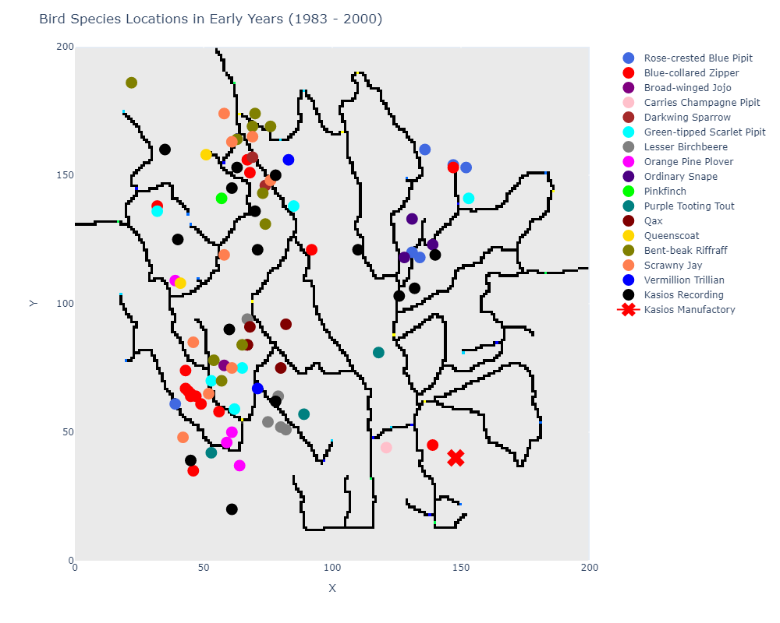
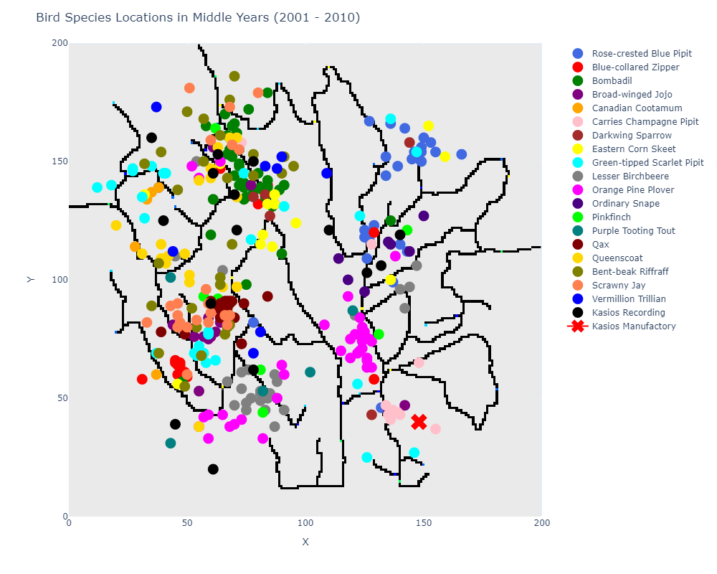
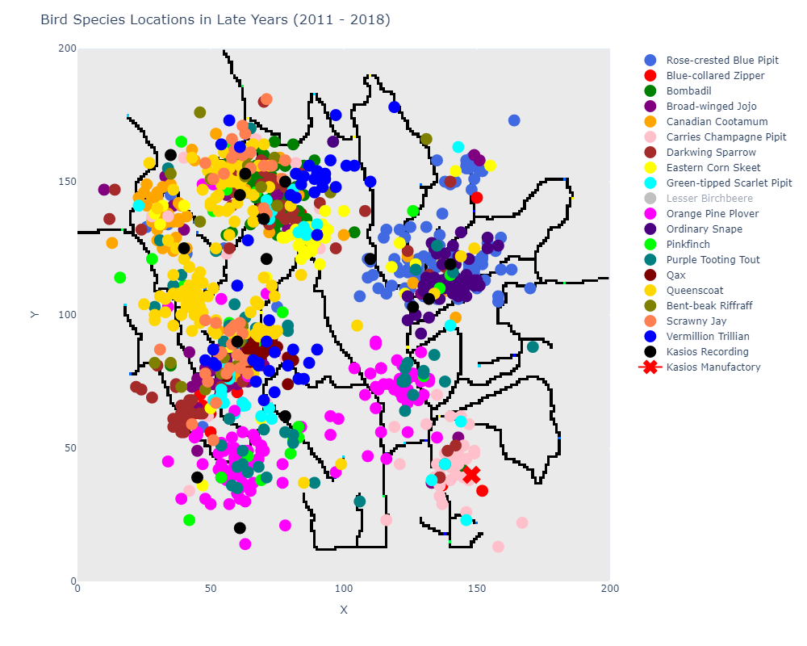
Data Exploration
Congregation Patterns of Birds in the Preserve Across Time
Birds tend to congregate in the same areas
Notes:
In general, the `Rose-crested Blue Pipit` seems to keep to the Northwest region in the map threw out time, and this doesn't change.
Observations for other birds of note:
* `Blue-collared Zipper`: In all years, most of the birds resided in the Southeast corner of the map, with a few outliers near the Kasios Manufactory between the years of 2011 and 2016. The birds then stop appearing during 2017/2018 minus one spotting back in the Southeast corner of the map.
* `Carries Champagn Pipit`: In all years, the birds seem to congregate around the Kasios manufacturing facility. This is true for later years (2017-2018), but the population did seem to decrease a bit.
* `Eastern Corn Skeet`: There seems to be a high population of this bird type in the eastern portion of the map, however after 2016 no more of these birds were spotted despite its large population in previous years.

